Slide 1
Student Marks Prediction
presented by:
- ayan pramanik
- Srikanta Pramanik

Slide 2
Introduction
The primary goal of this project is to create a predictive model that can estimate a student's future academic performance based on historical data. By analyzing past marks and relevant factors that may influence a student's success, such as study hours, test preparation, and attendance, we can uncover meaningful patterns and correlations.

Slide 3
About project
In this project, we have used linear regression to accurately identify the marks of the student base on their study hour.

Slide 4
IMPORTING REQUIRED LIBRARIES
Numpy
Pandas
Sklearn
Tkinter

Slide 5
SOFTWARE REQUIREMENTS:
Operating system: Windows 7/10/11
Coding Language: python
Development environment: anaconda, Jupiter
Dataset : students mark
IDE : Jupiter notebook

Slide 6
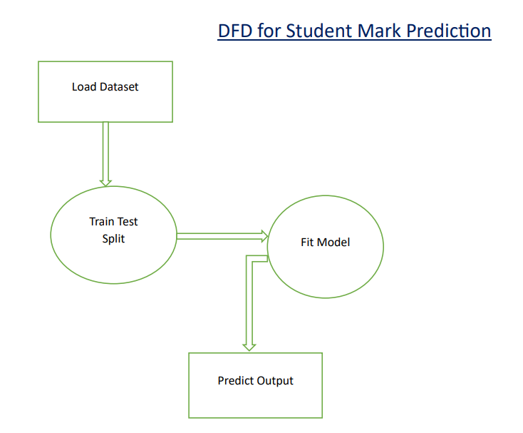
DATA PRE-PROCESSING
LOADING DATASET
TRAIN TEST SPLIT
Model Fit
Predict Output

Slide 7
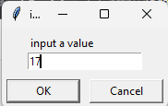
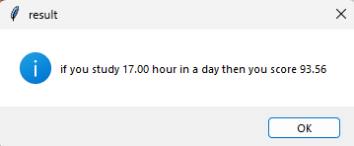
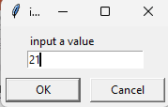
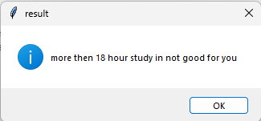
Results
Input : Output :

Slide 8
Advantages
Before the final marks of all subjects are evaluated prediction can be performed.
Using a machine learning process marks prediction can be done.

Slide 9
Disadvantages
Most of these methods work on data mining techniques that are based on complete data.
Early-stage evaluation is not possible in these methods.

Slide 10
Code Explaination

Slide 11
Thank You

